Slide 1
US Chronic Diseases
Nathan Savage
Frenci De La Cruz
Marah Alsharaiha

Slide 2
Table of contents:
Which states were these indicators/surveys collected from?
What are patients most common concerns?
Heat map visualization based on state and topic.

Slide 3
Where have these surveys been collected or conducted?

Slide 4
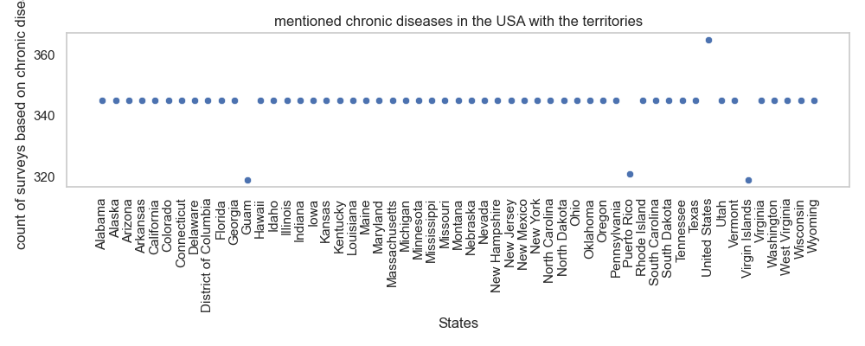
Mentioned chronic diseases in the USA with the territories

Slide 5
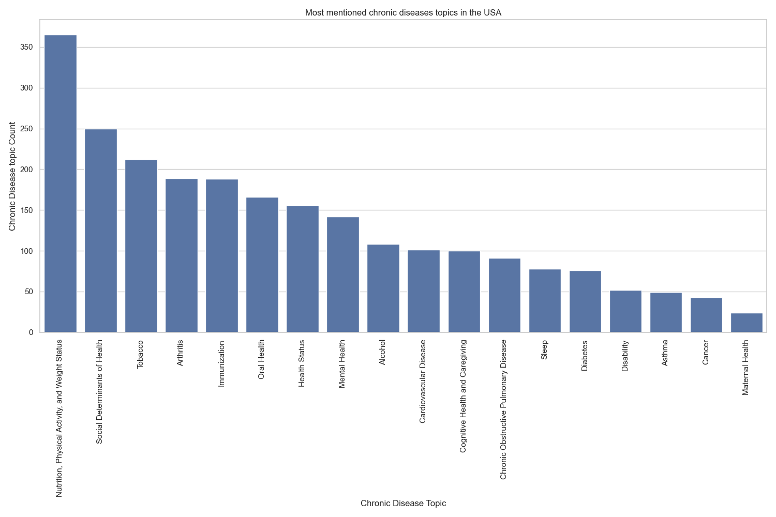
Mentioned chronic diseases topics in the USA without the territories

Slide 6
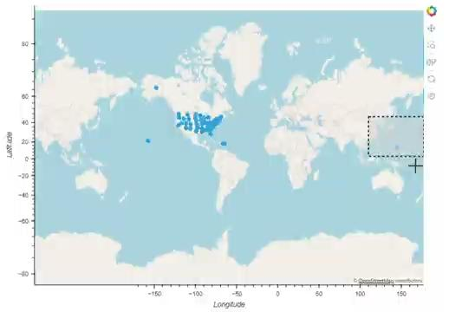
Demonstration map: Surveys by location

Slide 7
What are patients most common concern?

Slide 8
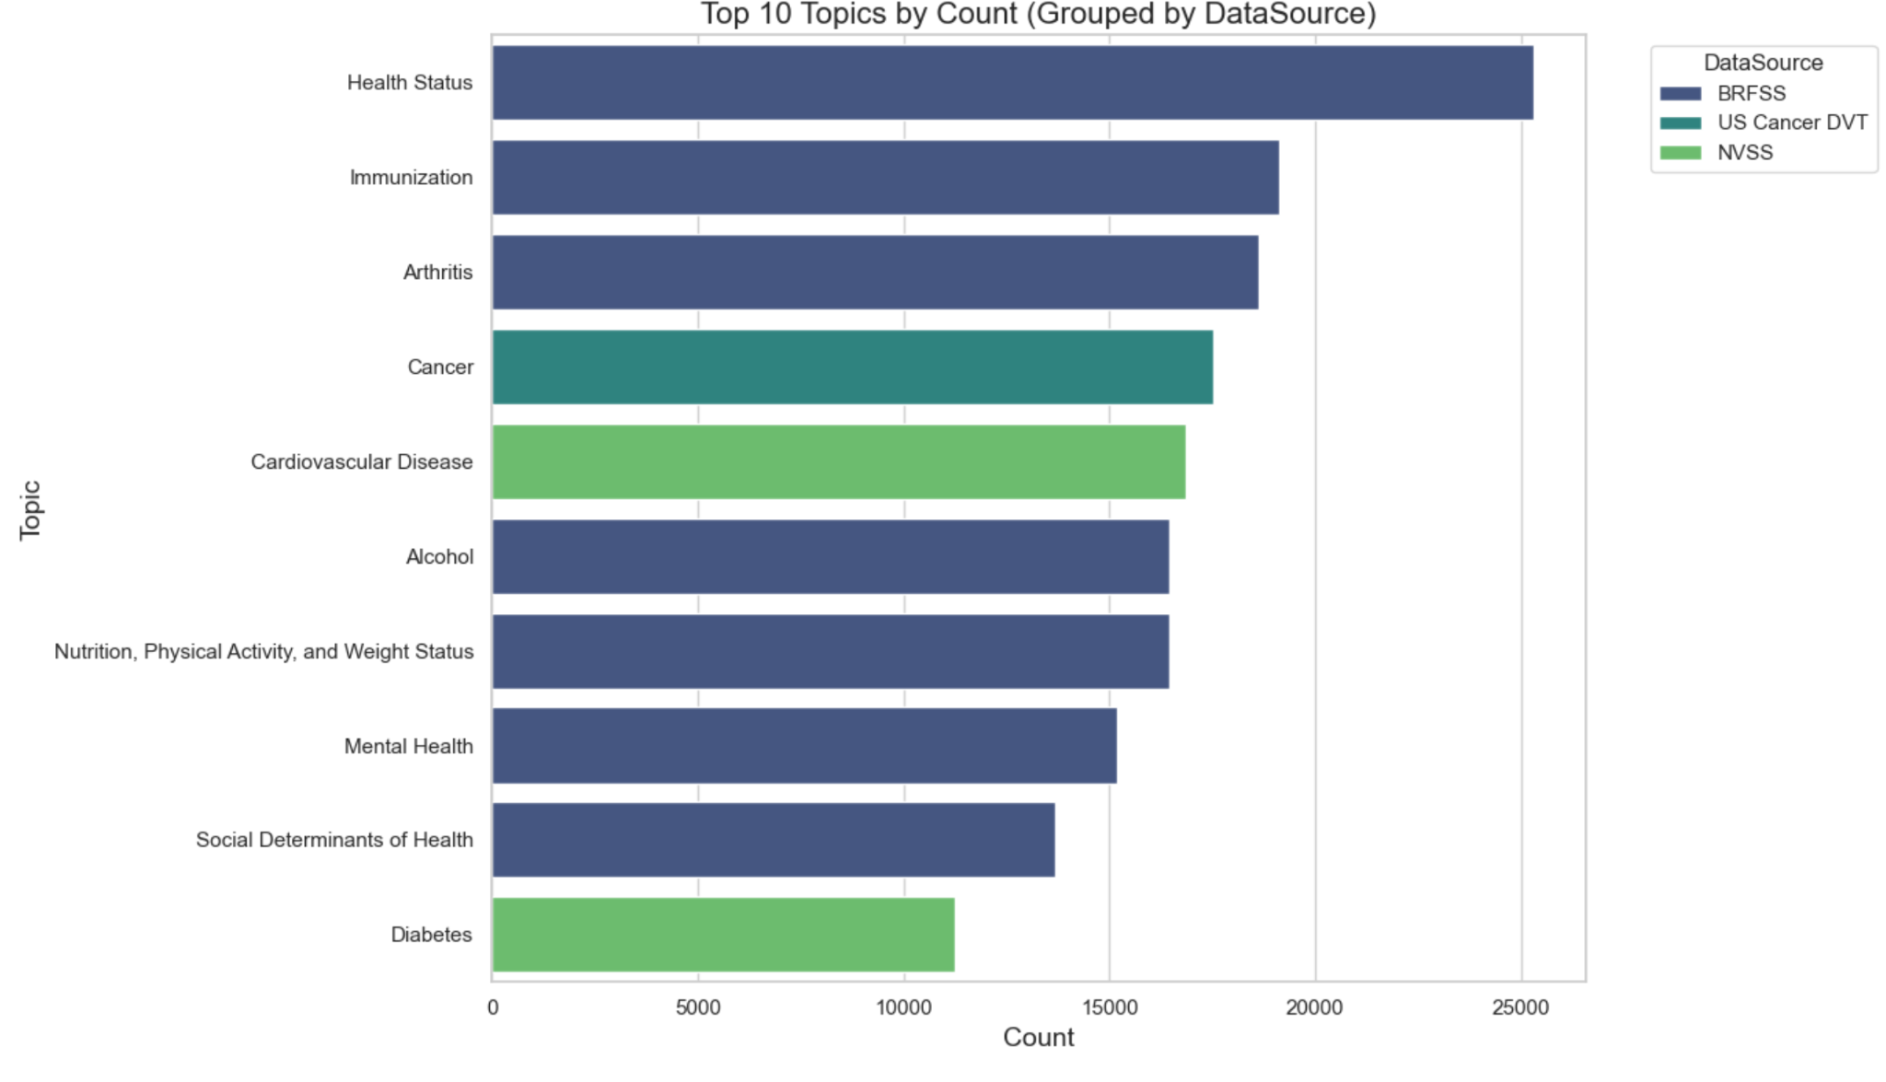
What are patients most common concern?

Slide 9
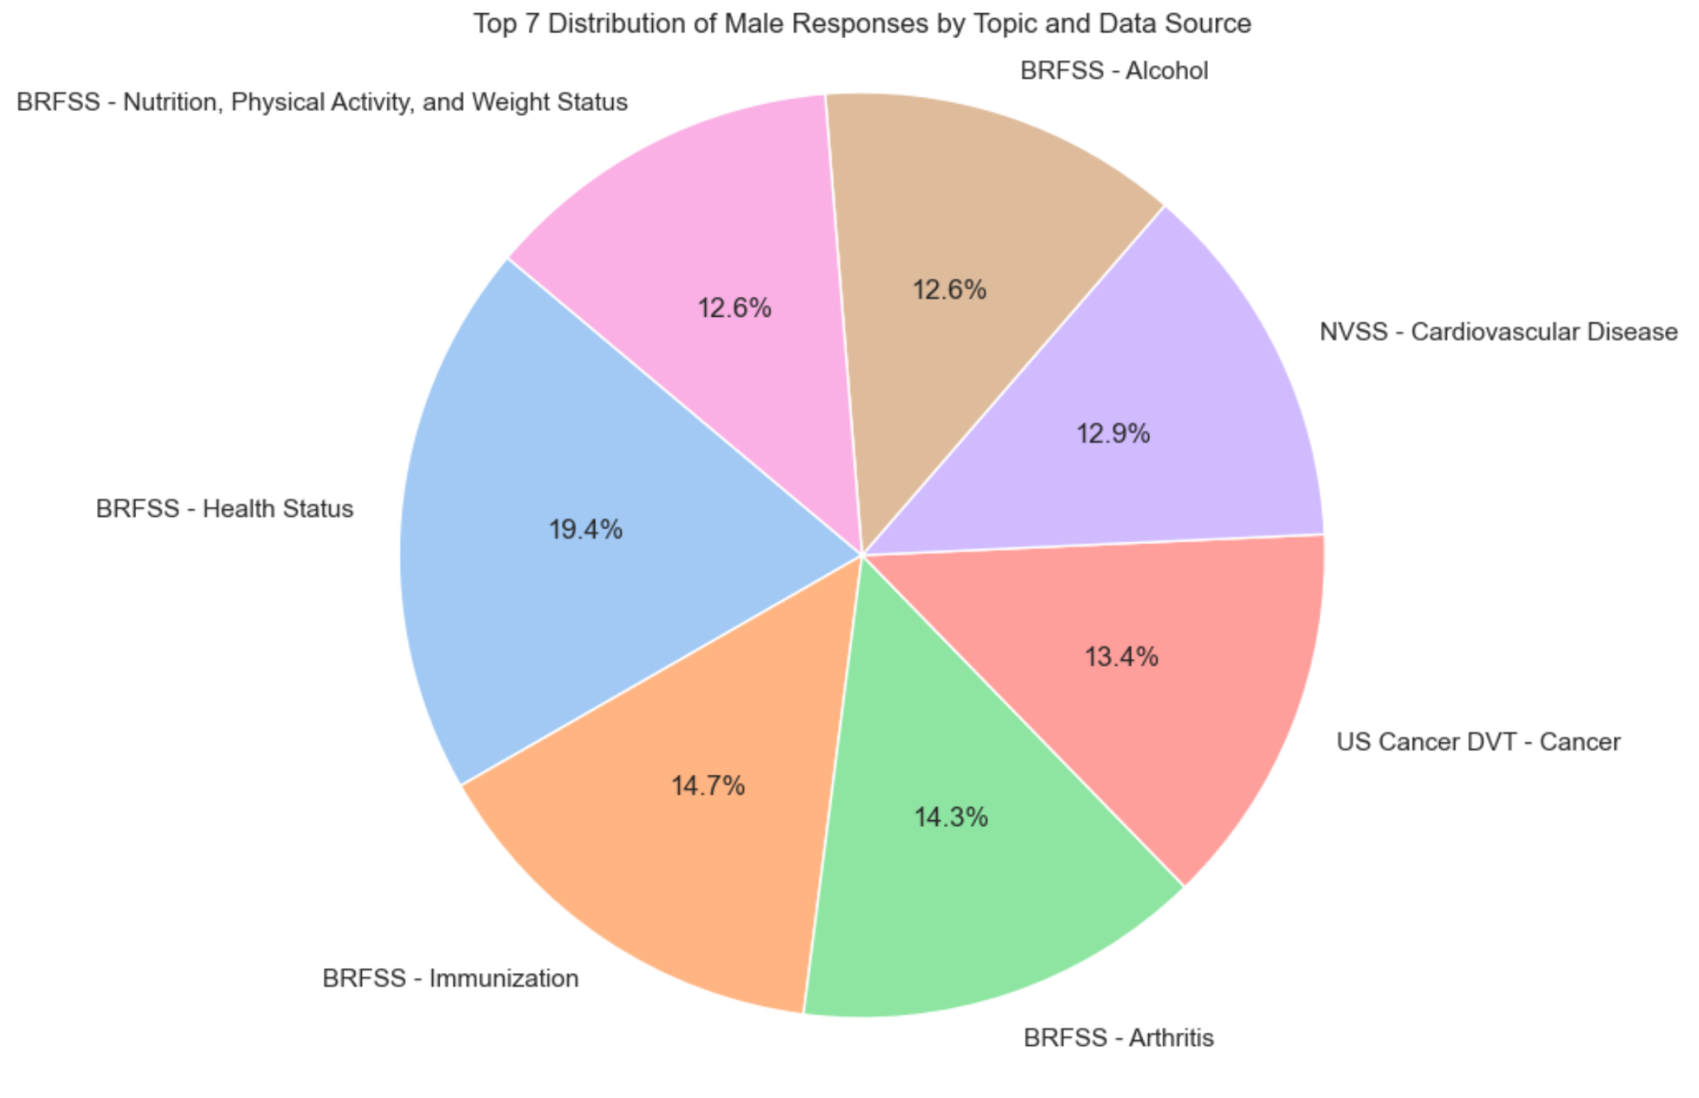
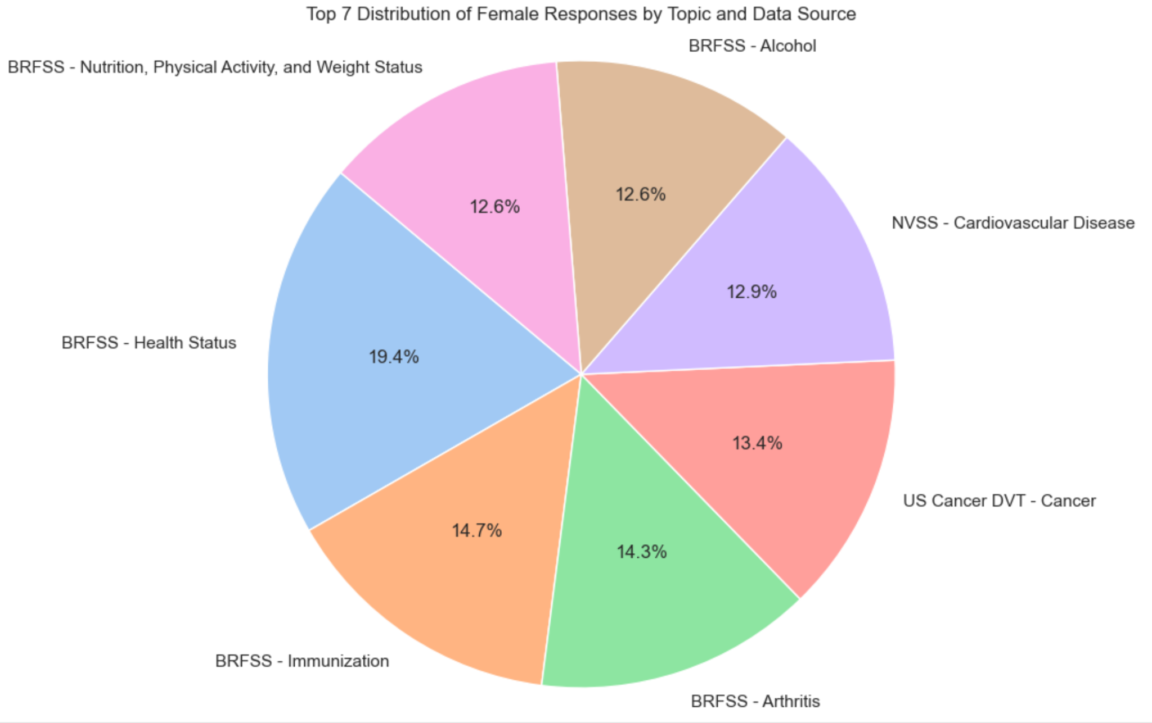
Male Vs Female

Slide 10
Heat Map Visualization

Slide 11
Heatmap
Live Demo

Slide 12
Sources:
CDC
Seaborn Doc
Seaborn Example

Slide 13
Conclusion
Question?

